Slide 1
CVS – concurrent versions system
  SANOG 10
  Network Management
  Workshop
  Aug 29 – Sep 2 2007
  New Delhi, India

Slide 2
Overview – what is CVS ?
  CVS is a Version Control System (VCS)

Slide 3
Contents
Part I
  version control and change managements
  introduction to CVS – principles, commands
  examples
  setting up a repository
  accessing the repository
  importing a project
  creating modules

Slide 4
Contents – cont'd
Part II
  the CVSROOT/ directory and its files
  pre- and post- jobs
  the big picture: mail notifications, cvsweb, and lists
  putting it all together
  automated scenarios

Slide 5
Overview – what is version control
Version control, and change management
  Keep track of changes (revisions)
  Share changes with others (public repository)
  Maintain multiple versions of a same set of data (branches)
What kind of data ?
  Source code
  Documentation
  Configuration files
  Binary data as well (less efficient)

Slide 6
CVS terminology
repository
  Central, master copy containing all files being versioned. Directory structured
working copy
  Local copy of a project, checked out from a repository. Contains special directories (CVS) with information about which files are under CVS control, where they files come from and where they should be committed.
module
  A set of directories, files or other modules under a common “shortcut” name

Slide 7

CVS principles
CVS uses a centralized “master copy”: the repository
All work is done in a working copy
Changes are committed back to the repository
Special directory, CVS

Slide 8
CVS – the repository
CVS is a centralized VCS (1 repository)
The repository contains files in the RCS format, all ending in ' ,v '
Each RCS file contains a complete history, with changelog, of the file being versioned
Well adapted to text files
The repository is NEVER edited by hand
A number of tools exist to analyze or browse the repository
  cvsweb/webcvs

Slide 9
CVS – the repository
Clients can access the repository locally or over the network.
The repository is indicated (UNIX) using the CVSROOT environment variable:
CVSROOT=
  /cvs/myprojects # local disk
  :pserver:myserver.com:/cvs/myprojects # via pserver
  :ext:user@myserver.com:/cvs/myprojects # via SSH
Allows for distributed work over LAN/WAN

Slide 10
CVS – example workflow
Initial checkout
  cvs co projectname initial checkout
  vi filename ... work ...
  cvs commit [filename] record changes
Later:
  cvs up update working copy
  from repository
  vi filename ... work ...
  cvs commit [filename] record changes

Slide 11
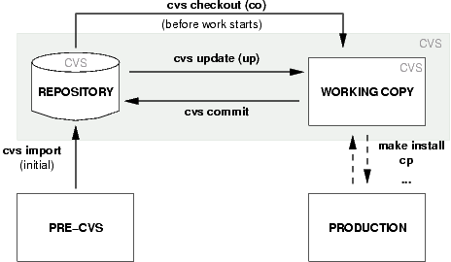
CVS – example workflow – cont'd

Slide 12
CVS clients
Exist for most operating systems
  cvs command line (UNIX, Win32)
  TortoiseCVS – embeds in Explorer (Win32)
  WinCVS (Win32)
  ...
Access the repository over the network or locally

Slide 13
CVS commands – action commands
import
  import a new project into an existing repository
checkout (co)
  check out a working copy of a project/file/module from the repository
update (up)
  update a working copy from the CVS version
commit
  commit changes back to the repository (incl. new files)

Slide 14
CVS commands – action commands cont'd
add
  add a new file in the working copy, ready to commit
delete (del)
  remove a file from the working copy, ready to commit

Slide 15
CVS command – status commands
status
  see the status and version of a given file or by default all files
diff
  show the difference between a given revision (by default: the last one) of the named file and the file in the working repository
log
  show revision history for one or more files

Slide 16
A working example
% CVSROOT=:ext:server.name:/data/cvs
% export CVSROOT
% cvs co someproject
Password: *******
cvs server: Updating someproject
U dir/file1
U dir/file2
...
% ls -l dir/
-rwxr-xr-x 2 regnauld staff 512 Dec 20 15:44 CVS/
-rw-r--r-- 1 regnauld staff 1244 Nov 17 14:21 file1
-rw-r--r-- 1 regnauld staff 341 Dec 3 21:04 file2
...
% vi file1
...
% cvs commit file1

Slide 17
A working example – cont'd
...................... editor ........................
/ Bugfix -- Modified file1 to fix bug /
\ \
/ CVS:---------------------------------------------- /
\ CVS: Enter Log. Lines beginning with `CVS:' are \
/ CVS: removed automatically /
\ CVS: \
/ CVS: Modified Files: /
\ CVS: file1 \
/ CVS:---------------------------------------------- /
\....................................................\
/tmp/cvsUABnYm: 8 lines, 290 characters
Checking in file1;
/data/cvs/dir/file1,v <-- file1
new revision: 1.2; previous revision: 1.1
done
%

Slide 18
What's in the CVS/ directory ?
Entries
  existing files, and newly added files
Root
  where is the repository located
Repository
  name of module or path in the repository

Slide 19
The CVS $Id$ directive
In an existing file, we add the following line
$Id$
Now cvs commit the file, and look at the file again

Slide 20
Setting up a new repository
Anyone can create a repository, anywhere
Done using the cvs init command
Example:
  mkdir /data/cvsrepo
  export CVSROOT=/data/cvsrepo
  cvs [-d /data/cvsrepo] init
  ls -l /data/cvsrepo
  drwxrwxr-x 3 pr staff 1024 Dec 20 15:45 CVSROOT/

Slide 21
Accessing the new repository
Locally
  cvs -d /data/cvsrepo ...
    Not necessary to specify -d if CVSROOT is defined
Remotely
  cvs -d :ext:servername:/data/cvsrepo ...
  SSH must be available!
Ready for import!

Slide 22
Importing a new project...
% CVSROOT=/data/cvs; export CVSROOT
% cd someplace/myproject/
% cvs import my/new/project before_cvs start
..................... editor ........................
/ Import pre-CVS version of my new project /
\ \
/ CVS:---------------------------------------------- /
\ CVS: Enter Log. Lines beginning with `CVS:' are \
/ CVS: removed automatically /
\....................................................\
N my/new/project/file1
N my/new/project/file2
...
No conflicts created by this import
%

Slide 23
Importing a new project...cont'd
The location for this project in the repository is now my/new/project, under the /data/cvs repository i.e.:
  /data/cvs/my/new/project
Let's test that we can check out the project:
% cvs co new/project
U my/new/project/file1
U my/new/project/file2
% cd my/new/project
% ls -l
...

Slide 24
Modules
my/new/project is maybe too long as a project name
solution: modules, which are shorter names for directories or groups of directories and other modules.
For example:
project my/new/project
With such a module defined, it will be possible to checkout, commit, etc... using the simple name “project”
cvs -d :ext:/data/cvs co project
We'll see how to define modules later.

Slide 25
The CVSROOT/ directory
A default module is always created when one inits a repository: CVSROOT
% cvs co CVSROOT
U CVSROOT/checkoutlist
U CVSROOT/commitinfo
U CVSROOT/config
U CVSROOT/cvswrappers
U CVSROOT/editinfo
U CVSROOT/loginfo
U CVSROOT/modules
U CVSROOT/notify
U CVSROOT/rcsinfo
U CVSROOT/taginfo
U CVSROOT/verifymsg

Slide 26
The CVSROOT/ directory – cont'd
Files described in cvs(5)
  man 5 cvs
Most relevant:
  modules define modules
  commitinfo pre-commit scripts
  cvswrappers handle special files
  loginfo post-commit scripts

Slide 27
Pre- and post- jobs
Using commitinfo and loginfo, it is possible to have automatic jobs run before and after each commit, for instance:
pre-commit stage (commitinfo)
  verify that a user is allowed to modify a given file
  check syntax for a file
  ...
post-commit stage (loginfo)
  send update as a mail
  append it to a log
  ...

Slide 28
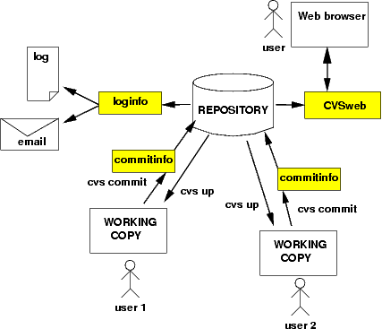
The big picture: mail, cvsweb, lists

Slide 29
Putting it all together...

Slide 30
CVS shortcomings
symlinks and ownership of files are not recorded
no renaming of files (copy + delete)
no changesets
  each file has 1 version, need postprocessing work to
  figure out “all files for this commit”
no disconnected operation
  add, remove, commit, ... all need access to the server
branching/merging is quite complicated

Slide 31
Automated scenarios
Idea: automatize configuration management tasks so that configuration files are automatically versioned using CVS...
... even when the sysadmin forgets :)
Implementation – cron job
  look at all files in a given directory
  if they exist in the repository already -> commit
  if they don't, add, then commit

Slide 32
Automated scenarios – cont'd
Already exists for network equipment: RANCID
  http://www.shrubbery.net/rancid/
Simple concept to implement for all relevant files in /etc
Subscribe all admins to the alias / mailing list, so everyone receives a notification when a change takes place – whether planned or not!

Slide 33
References
http://www.nongnu.org/cvs/
http://cvsbook.red-bean.com/
http://www.tortoisecvs.org/

